Slide 1
Week 001
Introduction to Production and Operations Management

Slide 2
Week 001: Introduction to Production and Operations Management
Learning Objectives
LEARNING OBJECTIVES
Be oriented with the basic concepts about the introduction to production and operations management
Identify important terms related to production and operations management
Examine the functions of production management
Analyze concepts and principles related to productivity
Examine the basic concepts and principles related to introduction to operations management

Slide 3
Week 001: Introduction to Production and Operations Management
Introduction to Production Management
PRODUCTION
an act of creating something useful
the planning, acquisition, utilization and control of physical resources employed in the provision of goods and services.

Slide 4
Week 001: Introduction to Production and Operations Management
Introduction to Production Management
IMPORTANCE OF PRODUCTION MANAGEMENT TO BUSINESS ORGANIZATION
It helps in the accomplishment of business organization’s objectives.
It increases the reputation, , goodwill and image of business organization.
It helps in introducing new products.

Slide 5
Week 001: Introduction to Production and Operations Management
Introduction to Production Management
IMPORTANCE OF PRODUCTION MANAGEMENT TO BUSINESS ORGANIZATION
4. It supports other business organization’s functional areas.
It helps the business to face competition in the market.
It facilitates the optimum resource utilization
It helps to minimize the production costs.
It helps in the expansion of business.

Slide 6
Week 001: Introduction to Production and Operations Management
Introduction to Production Management
IMPORTANCE OF PRODUCTION MANAGEMENT TO CUSTOMERS AND SOCIETY
Higher standard of living
Employment generation
Quality improvement and cost reduction
Spread effect
Creates utility
Boosts economy

Slide 7
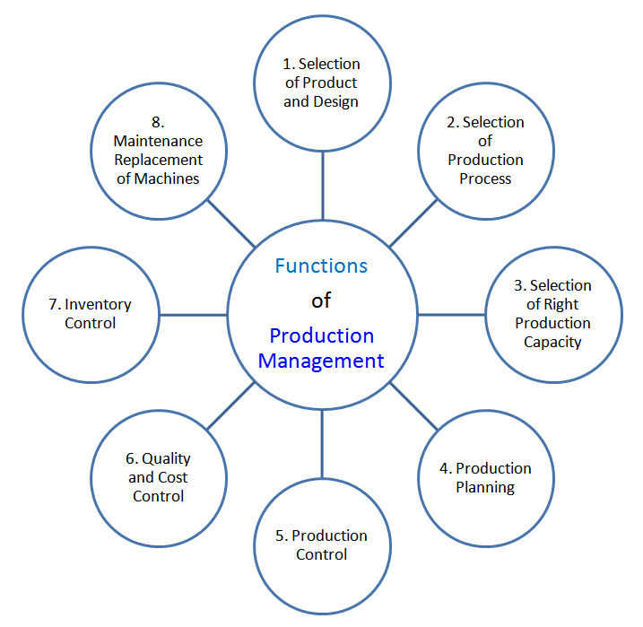
Week 001: Introduction to Production and Operations Management
Introduction to Production Management
FUNCTIONS OF PRODUCTION MANAGEMENT
Figure 1 Functions of Production Management
Ranjan, P. (2017, May 02). Production management, meaning, nature, function, PPC, production pla... Retrieved from https://www.slideshare.net/PrashantRanjan35/production-management-meaning-nature-function-ppc-production-planning-control

Slide 8
Week 001: Introduction to Production and Operations Management
Introduction to Production Management
FUNCTIONS OF PRODUCTION MANAGEMENT
Selection of product and design.
Selecting the right product to produce followed by selecting the right design for the product.

Slide 9
Week 001: Introduction to Production and Operations Management
Introduction to Production Management
2. Selection of production process.
The right production process must be selected.
3. Selecting the right production capacity
To match the demand for the product, right production capacity must be selected by production management.

Slide 10
Week 001: Introduction to Production and Operations Management
Introduction to Production Management
4. Production planning
It deals with deciding about the routing and scheduling.
ROUTING - deciding the work path and the operation sequence.
SCHEDULING - deciding when to start and when to complete a particular production activity.

Slide 11
Week 001: Introduction to Production and Operations Management
Introduction to Production Management
5. Production control
Monitoring and controlling the production should be done by the production manager.
Quality and cost control
To satisfy the demands of customers which is to have a good quality products at cheapest prices, production manager should continuously improve quality of products and to reduce the product costs.

Slide 12
Week 001: Introduction to Production and Operations Management
Introduction to Production Management
7. Inventory control
Level of inventories must be monitored so as to avoid overstocking and understocking.
8. Maintenance and replacement of machines
Efficient system for continuous inspection, cleaning, oiling, machine and equipment and spare parts maintenance and replacement should be considered and implemented by the production manager.

Slide 13
Week 001: Introduction to Production and Operations Management
Integrated Production Management
INTEGRATED PRODUCTION MANAGEMENT
refers to the use advanced manufacturing technology ( CIM, additive manufacturing, robotics, mechatronics and automation, micro and nano factories, sustainable and green manufacturing), JIT, TQM, human capital perspective and human resource management.

Slide 14
Week 001: Introduction to Production and Operations Management
Productivity
PRODUCTIVITY
refers to production process output per unit of input. To produce more with less is productivity.

Slide 15
Week 001: Introduction to Production and Operations Management
Productivity
DIFFERENT TYPES OF PRODUCTIVITY
Partial productivity
Total factor productivity
Total productivity

Slide 16
Week 001: Introduction to Production and Operations Management
Productivity
1. Partial Productivity
when the resources of productivity are measured separately. It plays an important role in productivity improvement.

Slide 17
Week 001: Introduction to Production and Operations Management
Productivity
2. Total Factor Productivity
When many of the resource inputs are available within the business organization , while few others are purchase are present in the production process.

Slide 18
Week 001: Introduction to Production and Operations Management
Productivity
3. Total Productivity
productivity is calculated considering all the resources. It is a qualitative and systematic to approach to complete the products considering the timer, price and quality.

Slide 19
Week 001: Introduction to Production and Operations Management
System Productivity
SYSTEM PRODUCTIVITY
the measuring the whole system in a certain firm if each part is working good – if the output is greater than the input in processing the said output.

Slide 20
Week 001: Introduction to Production and Operations Management
Capital Productivity
CAPITAL PRODUCTIVITY
refers to the company’s efficiency of converting the capital inputs into output.

Slide 21
Week 001: Introduction to Production and Operations Management
Capital Productivity
THREE WAYS TO IMPROVE PRODUCTIVE EFFICIENCY OF A FIRM
Improvement in technical efficiency
Technological progress and organizational change
Increasing returns to scale

Slide 22
Week 001: Introduction to Production and Operations Management
Labor Productivity
LABOR PRODUCTIVITY
refers to the value that each worker or employee creates per unit of his input.

Slide 23
Week 001: Introduction to Production and Operations Management
Labor Productivity
FACTORS WHICH DETERMINE LABOR PRODUCTIVITY
Human capital
Technological change
Economies of scale

Slide 24
Week 001: Introduction to Production and Operations Management
Labor Productivity
HUMAN CAPITAL
the accumulated knowledge that an individual acquired from education and experience, skills and expertise which an average employee possesses.

Slide 25
Week 001: Introduction to Production and Operations Management
Labor Productivity
TECHNOLOGICAL CHANGE
a combination of invention and innovation. Invention refers to the advancement in knowledge while innovation means using the said advancement to new products and services.

Slide 26
Week 001: Introduction to Production and Operations Management
Labor Productivity
ECONOMIES OF SCALE
cost advantages obtained which industries take advantage due to size.

Slide 27
Week 001: Introduction to Production and Operations Management
Personnel Productivity
FIVE MAJOR FUNCTIONS OF PRODUCTIVITY MEASUREMENT AND ALIGNMENT
Define productivity and direct behavior
Monitor performance and provide feedback
Diagnose problems
Facilitate planning and control
Support innovation

Slide 28
Week 001: Introduction to Production and Operations Management
Introduction to Operations Management
OPERATIONS MANAGEMENT
It focuses on the careful process management so as to produce and distribute goods and services.

Slide 29
Week 001: Introduction to Production and Operations Management
Introduction to Operations Management
ACTIVITIES IN OPERATIONS MANAGEMENT
Purchasing
Inventory control
Quality control
Storage
Logistics
Process evaluation

Slide 30
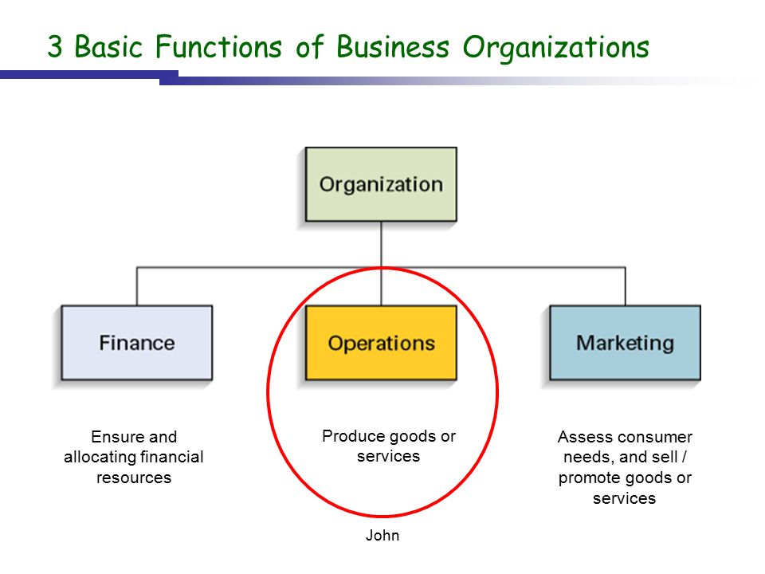
Week 001: Introduction to Production and Operations Management
Introduction to Operations Management
3 BASIC FUNCTIONS OF BUSINESS ORGANIZATION
Figure 2 - 3 Basic Areas/Functions of Business Organizations
Introduction to Operations Management (n.d.) Retrieved from http://slideplayer.com/slide/9246190/

Slide 31
Week 001: Introduction to Production and Operations Management
Introduction to Operations Management
3 FUNCTIONAL AREAS IN AN ORGANIZATION
Finance – the area which is responsible for securing resources related to finances at favorable price as well as the its allocation.
Marketing Area – responsible for the consumer needs and wants assessment.
3. Operations Area – responsible for the production of goods and services to customers.

Slide 32
Week 001: Introduction to Production and Operations Management
Operations Management and Strategy
STRATEGIC OPERATIONS MANAGEMENT
highlights the importance of devoting lots of attention to environment analysis and strategy formulation which relate direct to environmental changes.

Slide 33
Week 001: Introduction to Production and Operations Management
Operations Management and Strategy
STEPS IN THE STRATEGIC
MANAGEMENT PROCESS
Environmental scanning
Strategy formulation
Strategic implementation
Evaluation control

Slide 34
Week 001: Introduction to Production and Operations Management
Operations Management and Strategy
1. ENVIRONMENTAL SCANNING
external and internal environments are scanned and ends with monitoring of organization’s activities.

Slide 35
Week 001: Introduction to Production and Operations Management
Operations Management and Strategy
2. STRATEGY FORMULATION
Formulation of strategies at the following levels is done here.
a. Corporate Level
b. Business unit level
c. Functional level

Slide 36
Week 001: Introduction to Production and Operations Management
Operations Management and Strategy
TYPICAL STRATEGIES FOR
THE CORPORATE LEVEL
Growth strategies
Business unit level
Retrenchment strategies

Slide 37
Week 001: Introduction to Production and Operations Management
Operations Management and Strategy
3. STRATEGY IMPLEMENTATION
In this stage, the strategies formulated are implemented in the business.

Slide 38
Week 001: Introduction to Production and Operations Management
Operations Management and Strategy
STRATEGIC FORMULATION vs.
STRATEGIC IMPLEMENTATION
Strategy formulation is positioning before action while strategy implementation is the managing forces during the action;
Effectiveness is the focus in strategy formulation while efficiency in strategy implementation
Primarily, strategy formulation is an intellectual process while strategy implementation is an operational process.

Slide 39
Week 001: Introduction to Production and Operations Management
Operations Management and Strategy
Good intuitions and operating skills are required in strategy formulation while motivation and leadership skills are required in the implementation
Co ordination among few individuals are required in strategy formulation while in the implementation, co ordination among many persons are required
For small, large or non profit organization, strategy formulation does not vary while strategy implementation varies among the different sizes and types of industries.

Slide 40
Week 001: Introduction to Production and Operations Management
Operations Management and Strategy
EVALUATION AND CONTROL
The following steps are done during this stage:
Performance targets, standards, and tolerance limits for the objectives are established.
Measuring the performance and managers will be informed if the outcomes are outside the limits.
From the accepted limits, analyze deviation
Modifications will be executed, if necessary.

Slide 41
Week 001: Introduction to Production and Operations Management
Tools for implementation of Operations
TOOLS FOR SETTING UP OF SCHEDULES FOR THE OPERATION
Gantt Charts
PERT Charts
Computer-aided design software package (CAD)
Computer-aided manufacturing software system (CAM)
Computer-integrated manufacturing system

Slide 42
REVIEW OF THE LESSON

